Slide 1
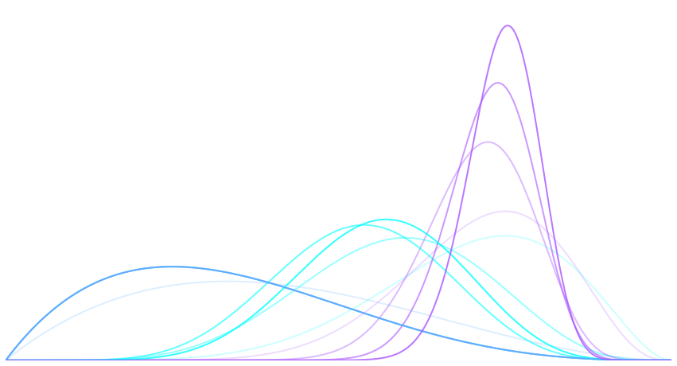
Content Optimization with Multi-armed Bandits
Notes:
Hello everyone, and welcome to Bandit Learning. In this course we will cover the topic of Multi-Armed Bandits.
If you are here, thinking you will learning how to rob a train and escape into the woods, this is the wrong course. Wrong bandits.

Slide 2
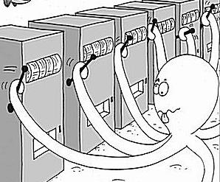
Course syllabus
Motivation
Bandits
Visualization
Data
Simulation
http://research.microsoft.com/en-us/projects/bandits/
Notes:
Our first course of action will be to discuss the motivation for MABs. We assume the student has some familiarity with the Python programming language, and a few choice graphics packages, such as matplotlib and seaborn. In section 2 we present a few popular bandit strategies, an explanation of how to implement them in Python. In section 3 we go over the variety of data types typically encountered in the real world, such as stationary data—data that does not change—restless data—data that changes—and volatile (or mortal) data—data that is born, exists for some time, and then dies. In section 4 I will show how to simulate systems that use bandits, bringing together the first 3 section. And in section 5, we will develop some applications that use bandits. The first is a command line demo that lets you play against a bandit. The second is a full implementation of a website that uses bandits to learn use preferences.

Slide 3
Motivation
We are presented with a set of options of unknown rewards. We want to select the best option from among the set to maximize our total reward.
A randomized, continuous experiment with K variants/arms
Balance exploitation with exploration
Maximize reward, minimize regret
From Microsoft Research:
“The [multi-armed bandit] problem is a classical paradigm in Machine Learning in which an online algorithm chooses from a set of strategies in a sequence of trials so as to maximize the total payoff of the chosen strategies.”
http://research.microsoft.com/en-us/projects/bandits/

Slide 4

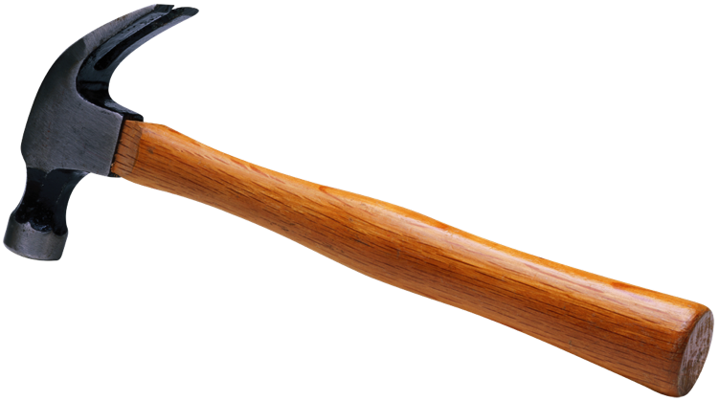
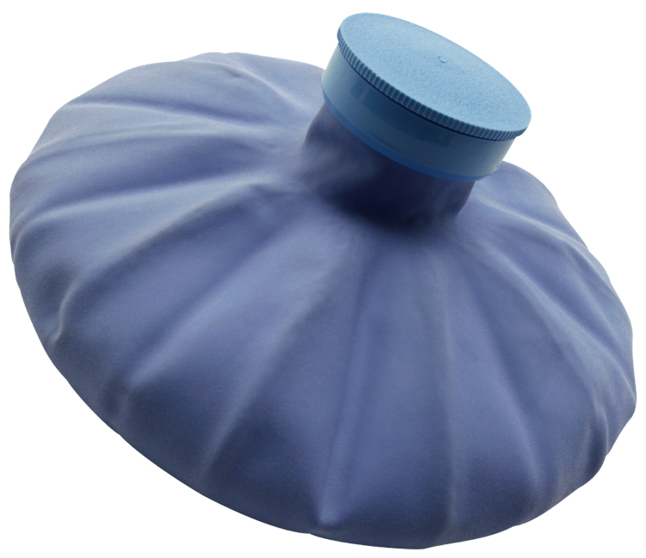
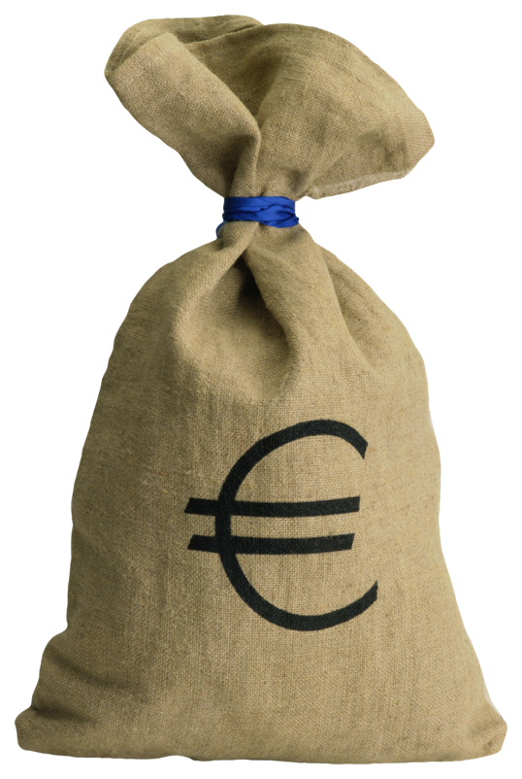
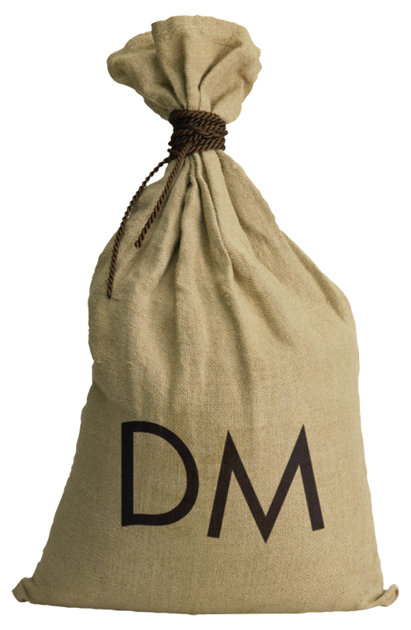



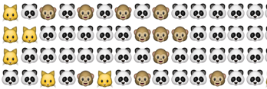
Motivation
Marketing:
How do you choose an email subject line that will maximize open rates?
How do you determine the best layout for a landing page or email?
Which button color results in the highest click through rate?
Clinical Trials:
How do you test two new drugs in the field while minimizing harm to the patient?
Finance:
Which markets should you invest in?
Management:
Which employee should be assigned a task?
Internet Advertising:
Which advertisement should I present to a particular visotor?
Sports:
Which player should be a starter?

Slide 5
Multi-Armed Bandits, In Brief
Goal
Pick the best from a set of options
Given
Options have different rewards
Problem
Do not know initially know which option is best
Cold start
Strategy
Balance exploration with exploitation
Name of Strategy: Multi-Armed Bandits
Notes:
The benefits of this course are many.
You will learn advanced Python programming. Learn how to make awesome visualizations that convey how bandits operate

Slide 6
A/B Testing
A randomized experiment with 2 variants, A and B
Extendable to K variants: A/B/C/D/… testing
2 options: 1/2 split for t time
Collect data
Pick best
4 options: 1/4 split for t time
Collect data
Pick best
K options: 1/k split
Collect data
Pick best
Notes:
This is an overview of how A/B testing works.

Slide 7
What are we trying to do?
We are trying to avoid the waiting time of A/B testing, and instead always pick the best A or B at a given time step
Each arm or option has some unknown reward distribution
We want to obtain the most reward over a period of T trials
(Cold start) Problem
Given no initial data about the reward distributions, how do we pull the arms in order to maximize our total reward?
We want to estimate the reward of each arm
Solution
Pull arms in a way that maximizes your reward, based on what you currently know

Slide 8
The Multi-Armed Bandit
A randomized, continuous experiment with K variants/arms
Balances exploitation with exploration
K options/arms
One bandit algorithm:
Explore the solution space p % of the time
Exploit the best option (1-p) % of the time
Measurement of goodness: regret
The difference between the best total reward and the total rewards of the arms you played
Allows you to make online decisions based on incomplete data that maximize your reward
Notes:
“online” here does not mean “on the internet.” it means “an algorithm that processes it’s data piece-by-piece without knowing what data is coming next. The future input is unknown.” this is in contrast to an “offline” algorithm, where all data can be held at once.

Slide 9
5 bandit algorithms
Greedy
Always choose the best performing option
Epsilon Greedy
Explore the solution space p % of the time
Exploit the best option (1-p) % of the time
Epsilon Decreasing
Same as above, but p decreases with time
Upper Confidence Bound (UCB)
Take the option with the highest upper confidence interval
This is called an optimistic policy
Bayesian Bandits
a.k.a. Thompson sampling
Sample K beta distributions, take index of highest sample
Notes:
Explain more about confidence intervals,
For UCB, the policy is optimist because the confidence interval is just a likely range, and we must be optimistic when choosing it.

Slide 10
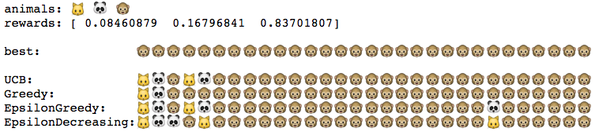
Example: Choosing Emoji
Goal: you want to elicit a smile from someone via text message
Problem: which animal face in a text results in the broadest smile?
Choices: cat face, panda face, monkey face
The (unknown) best choice is monkey face
Notes:
Explain that the rewards are the probabilities of obtaining a smile.
Explain that time moves from left to right in the “print out” of the policy selections/decisions

Slide 11
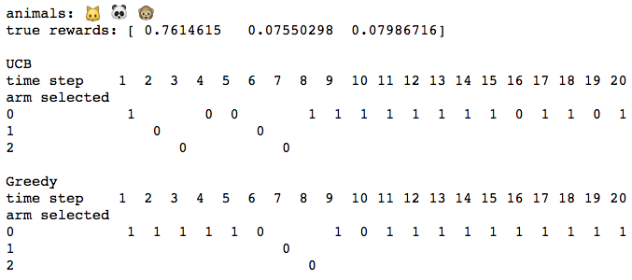
Example: Choosing Emoji
Notes:
A closer look…
Here we show the internals of the algorithm for two policies. The next slides shows the other two.
Time goes from left to right. Options are 0,1,2, and at each time step we show a 0/1 entry. The row indicates which option we chose: 0, 1, or 2. The results, 0 or 1, shows if the option was taken, e.g., the button was clicked.
Since the first option, cat face, has a reward of 0.76, it is the best of the three options. Likewise, all 4 policies eventually, after some initial experimentation, pick the first option, which corresponds to row 0.

Slide 12
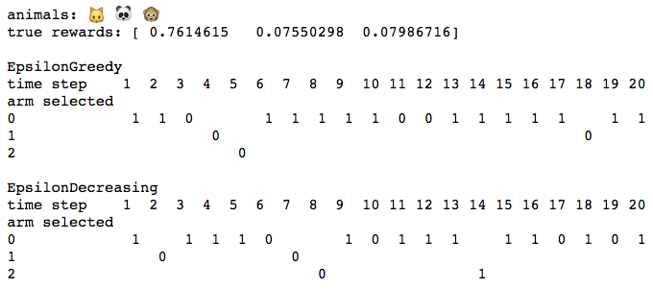
Example: Choosing Emoji
Notes:
A closer look, continued.

Slide 13
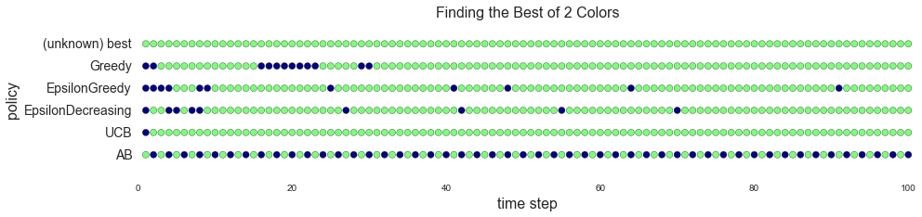
Example: Choosing Button Colors
Goal: you want people to click a button
Problem: which button color results in the highest click-through rate?
Choices: green, blue
The (unknown) best choice green
Notes:
Explain that the rewards are the probabilities of obtaining a smile.
Explain that time moves from left to right in the “print out” of the policy selections/decisions.
Highlight the A/B test at the bottom row.

Slide 14
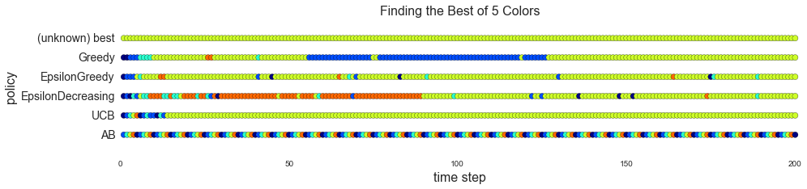
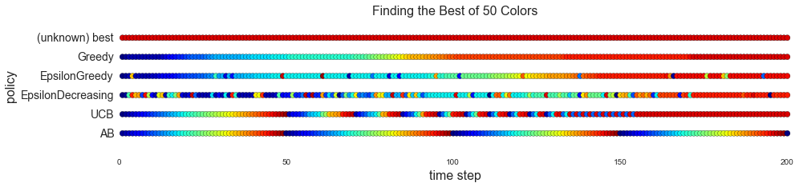
Example: Choosing Button Colors
Notes:
Explain that the rewards are the probabilities of obtaining a smile.
Explain that time moves from left to right in the “print out” of the policy selections/decisions.
Highlight the A/B test at the bottom row. This is pure exploration, as opposed to the 4 policies above it, which attempt to learn and pick the best performing option, which, eventually, is the optimal (best) option.

Slide 15
Generating data
Static data
Same number of options
Constant probabilities for each option
Except volatile static
Changing arms, changing expected value
Dynamic data
Restless
Expected values of arms changes over time
Volatile
Arms can be removed and replaced

Slide 16
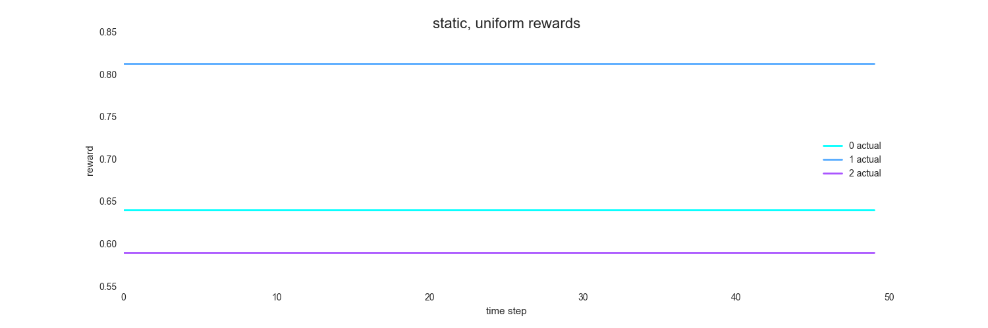
Static Data

Slide 17
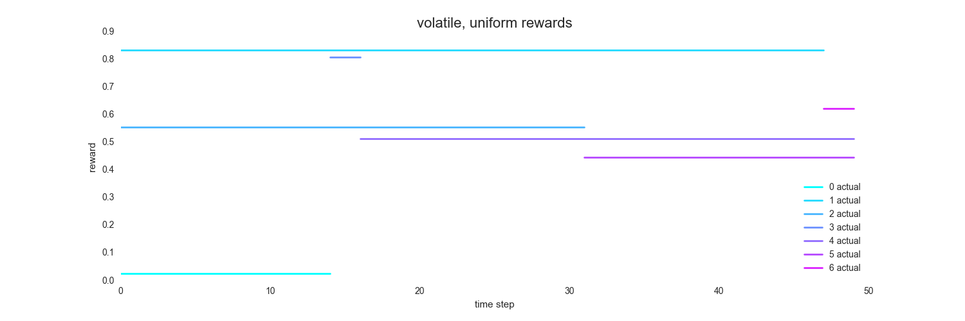
Static Volatile Data

Slide 18
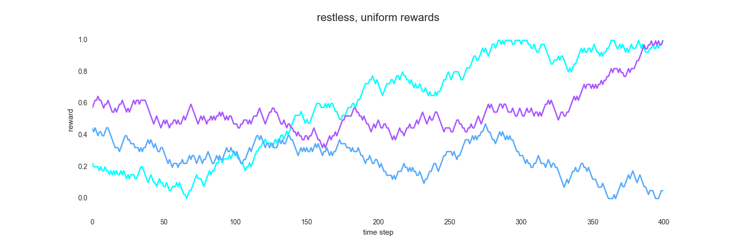
Restless Data

Slide 19
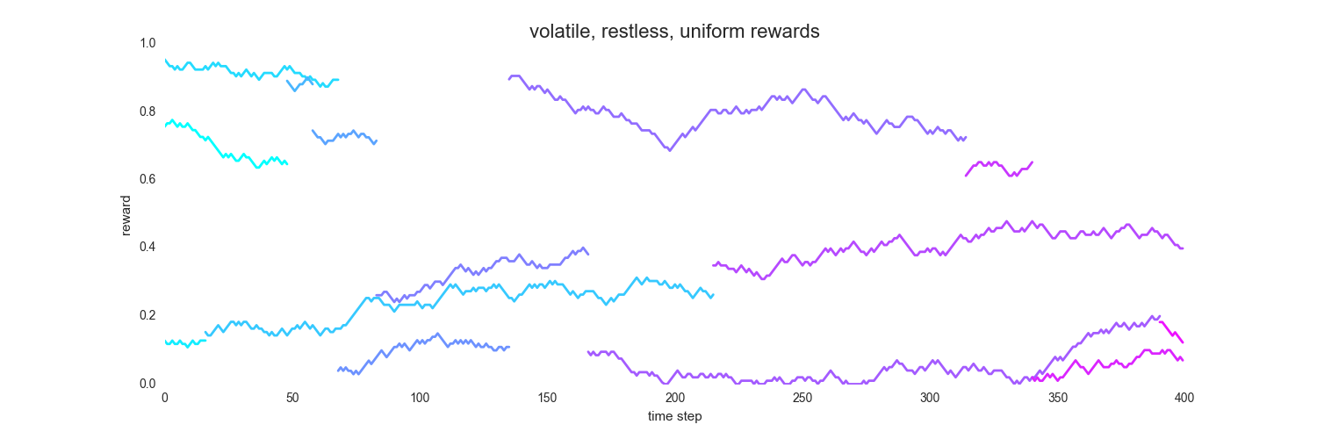
Restless, Volatile Data

Slide 20
Generating and plotting static data
gen_static_uniform(k, T)
The function generates uniformly distributed static data
gen_static_beta(k, T, a, b)
For both functions the parameter k is the number of bandit arms and the parameter T is the number of time steps
For the beta data, a and b are parameters of the beta probability density function
plot_static(actual, x_range, title, figsize, colormap, axis)
The parameter actual is the actual data (as opposed to the bandit estimates of the data). The other parameters are cosmetic.
Notes:
We will discuss the implementation of these data generating functions in the lab.

Slide 21
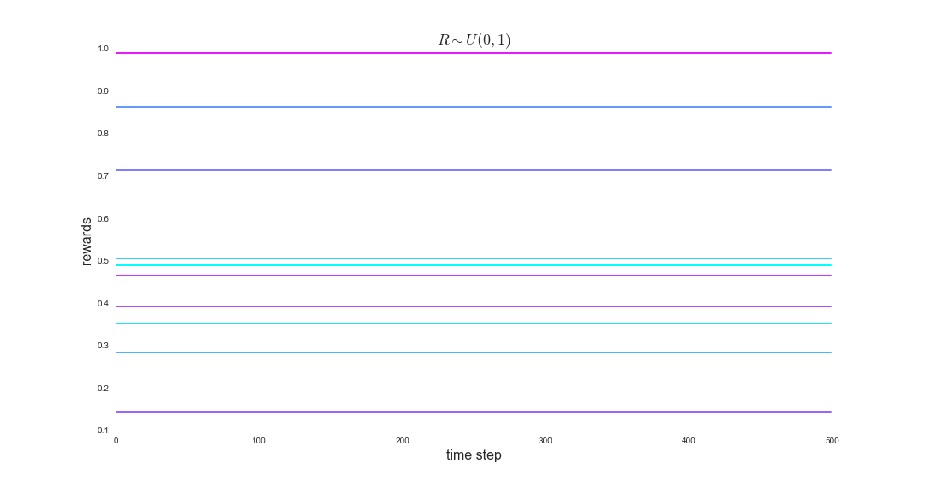
Static, uniform data

Slide 22
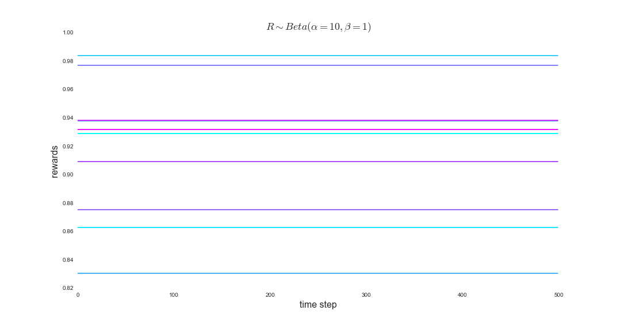
Static, beta data

Slide 23
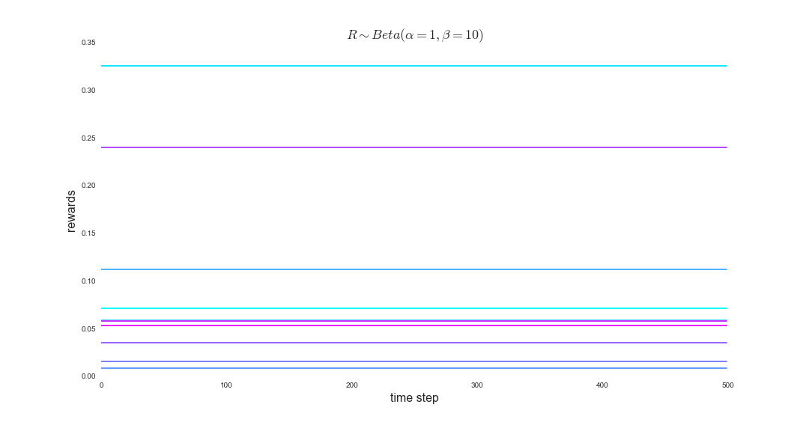
Static, beta data

Slide 24
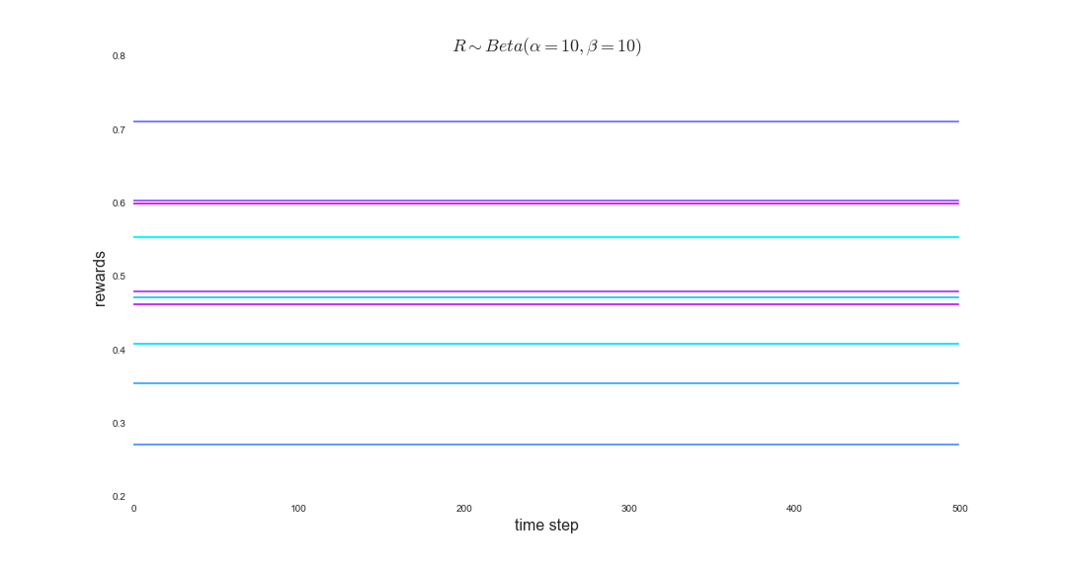
Static, beta data

Slide 25
(a subset of) Bandit Strategies
Greedy
Epsilon-greedy
Epsilon-decreasing
Upper Confidence Bound (UCB)
Exponential
Bayesian (Thompson sampling)

Slide 26
Our First Algorithm: Greedy
Policy
Always pick best performing arm
Caveat
Incorrect initialization of arms can lead to arms that are never played more than once
Maybe does not explore sufficiently
Maybe too certain an arm is bad, or good
“Greed is good” – Gordon Gecko, Wall Street, 1987
indeed it is, in this context
Notes:
Explain what thompson samling is or avoid it

Slide 27
Greedy
Class Greedy
Methods within the Greedy class are
init(n_arms)
add_arm()
remove_arm(arm_id)
reset_arm(arm_id)
update(arm_id, reward)
These methods are essentially the same for all bandit classes
The main difference is the choose_arm() method
Notes:
This and the next two slides show the code for the Greedy class

Slide 28
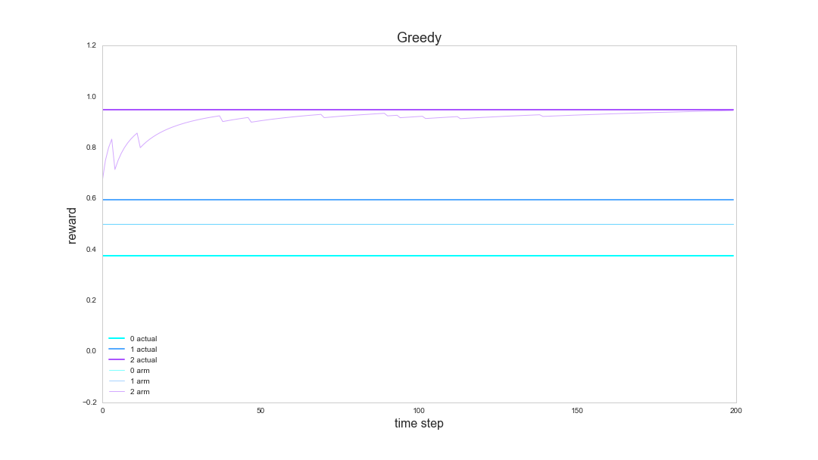
Greedy - performance
Notes:
2 options, depicted by blue and purple solid lines.
Transparent lines are the bandit algorithm’s belief of what the solid lines are.
Transparent blue line is way off, because the Greedy algorithm no longer explores it once it was determined that there is a better option—the purple line.

Slide 29
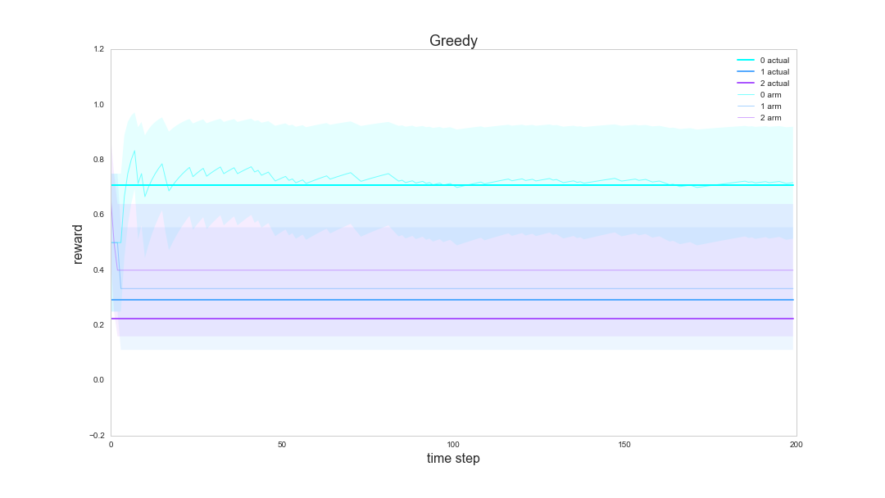
Greedy - performance
Notes:
2 options, depicted by blue and purple solid lines.
Transparent lines are the bandit algorithm’s belief of what the solid lines are.
Transparent blue line is way off, because the Greedy algorithm no longer explores it once it was determined that there is a better option—the purple line.

Slide 30
Epsilon Greedy
Similar to Greedy
Pick best performing arm most of the time, explore other arms the rest of the time
Takes parameter ε
Typically ε = 0.1
Basic algorithm
With probability ε, explore
With probability 1-ε, exploit

Slide 31
Epsilon Greedy
Class EpsilonGreedy
Methods within the EpsilonGreedy class are
init(n_arms, epsilon)
add_arm()
remove_arm(arm_id)
reset_arm(arm_id)
update(arm_id, reward)
The main difference from the Greedy bandit is the choose_arm() method

Slide 32
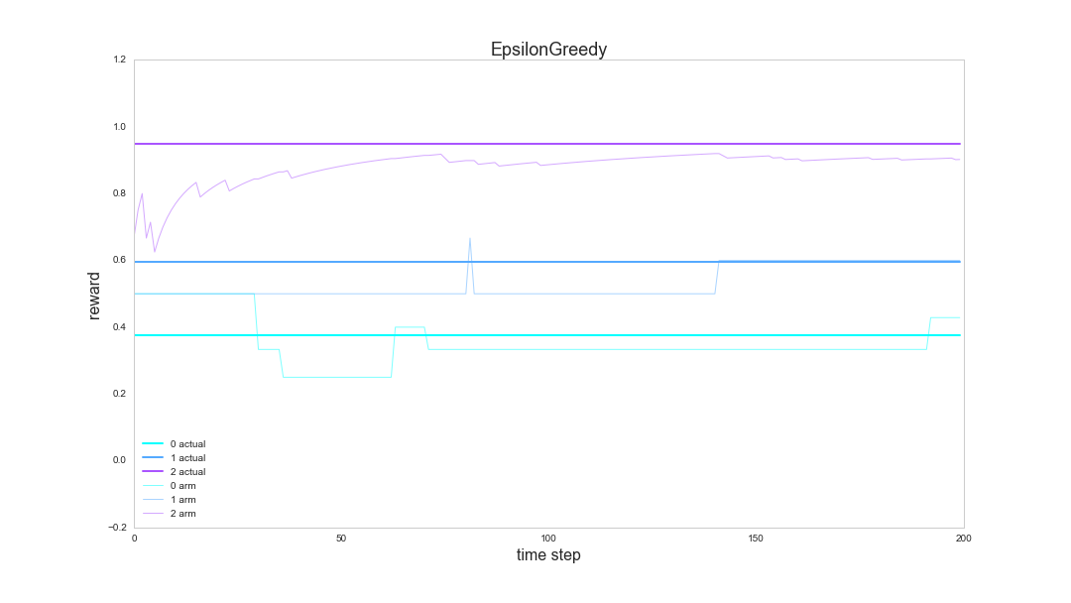
Epsilon Greedy - performance
Notes:
Very similar performance to Greedy, but it continues to explore, albeit not frequently, the lesser performing option—blue.

Slide 33
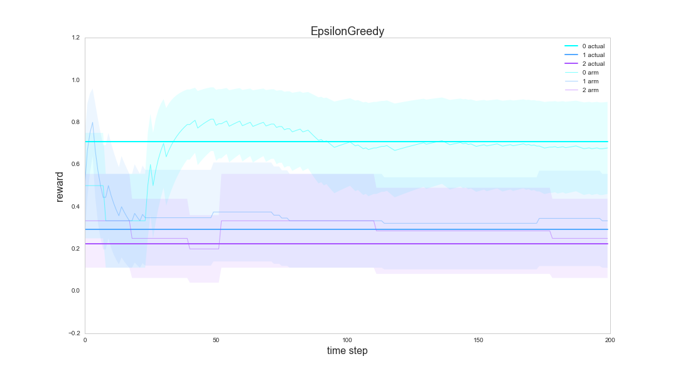
Epsilon Greedy - performance
Notes:
Very similar performance to Greedy, but it continues to explore, albeit not frequently, the lesser performing option—blue.

Slide 34
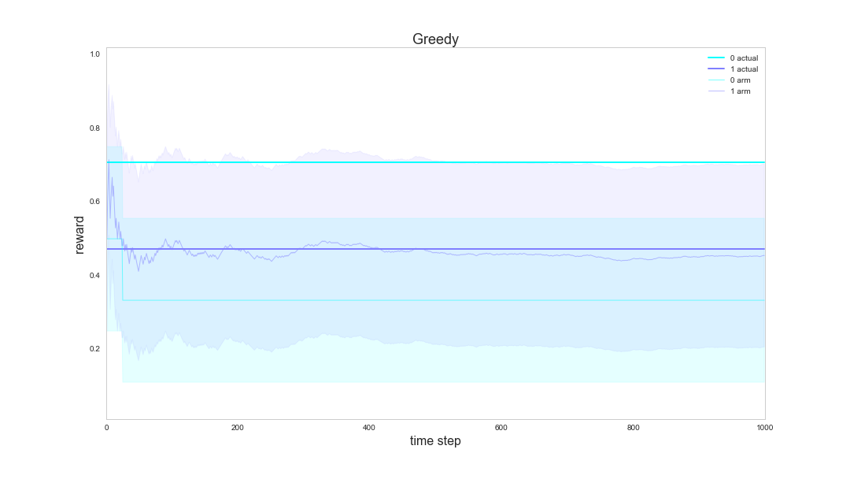
Epsilon Greedy – bad performance
Notes:
Very similar performance to Greedy, but it continues to explore, albeit not frequently, the lesser performing option—blue.

Slide 35
Epsilon Decreasing
Like Epsilon Greedy
However, the parameter ε decreases over time
Many ways to do this: linearly, exponentially, logarithmically, etc.
This leads to less exploration and more exploitation, over time
After a certain point (that you specify statically or as a function of t), explore less and exploit more
Epsilon Increasing
function of accuracy
Notes:
Remove technical stuff or over-explain

Slide 36
Epsilon Decreasing
Class EpsilonDecreasing
Methods within the EpsilonDecreasing class are
init(n_arms, epsilon)
add_arm()
remove_arm(arm_id)
reset_arm(arm_id)
update(arm_id, reward)
The main difference from the Greedy bandit is the choose_arm() method
Notes:
Remove technical stuff or over-explain

Slide 37
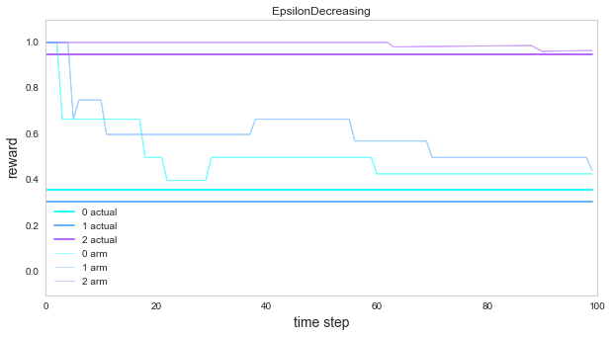
Epsilon Decreasing - performance

Slide 38
Epsilon Decreasing - performance

Slide 39
Upper Confidence Bound (UCB)
Optimism in the face of uncertainty
Always pick the arm with the highest upper confidence bound
Upper confidence for arm i : c*sqrt(2log(T)/n)
n is the number of times arm i was played
T is the total number of arms played for all arms I, 1 <= i <= k
So we pick the arm that maximizes x + c*sqrt(2log(T)/n)
x is the estimated mean of the arm
Optimist policy
Notes:
At beginning, review sqrt, logs, etc, mathy math

Slide 40
Upper Confidence Bound (UCB)
Class UCB
Methods within the UCB class are
init(n_arms, default_count, default_values)
choose_arm()
reset_arm(arm)
update(arm, reward)
get_arm_data()
The main difference from the previous bandits polices are the choose_arm() and get_variance method
Notes:
Remove technical stuff or over-explain

Slide 41
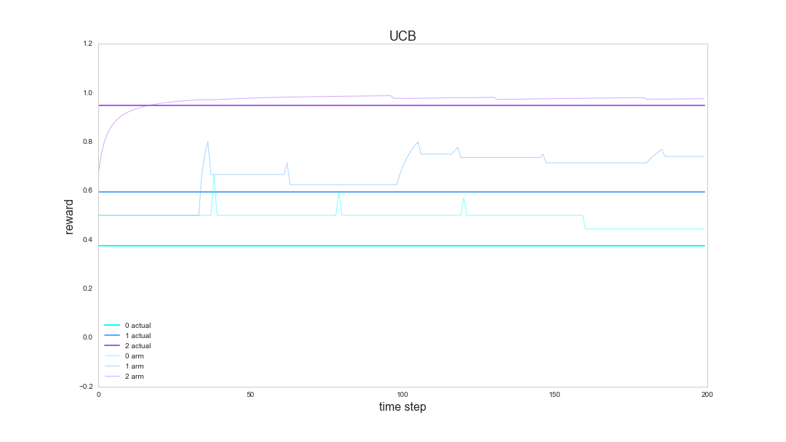
UCB - performance

Slide 42
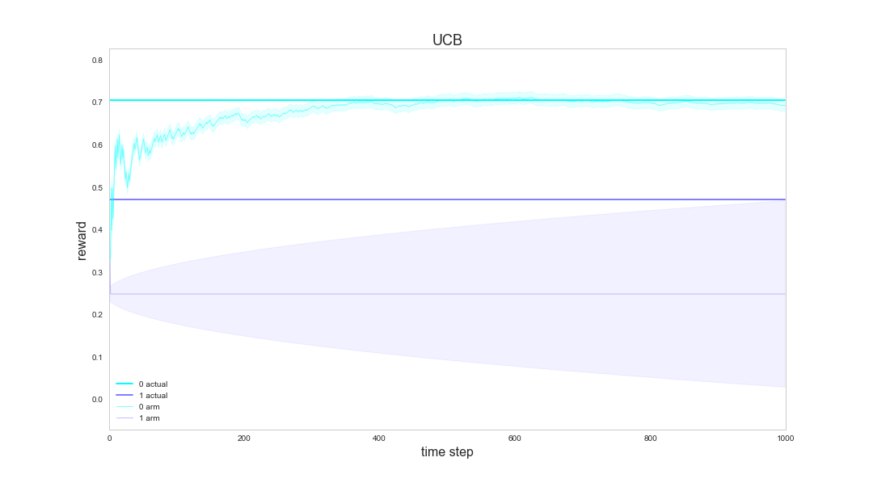
UCB - performance

Slide 43
Bayesian Bandits
Uses Beta distribution to model beliefs
Always pick the arm with the highest random sample from it’s Beta prior
Observe reward, update prior
Continue
Notes:
At beginning, review sqrt, logs, etc, mathy math

Slide 44
Bayesian Bandits
Class Bayesian
Methods within the Bayesian class are
init(n_arms, default_count, default_values)
choose_arm()
reset_arm(arm)
update(arm, reward)
get_arm_data()
The main difference from the previous bandits polices are the choose_arm and get_arm_data method
Notes:
Remove technical stuff or over-explain

Slide 45
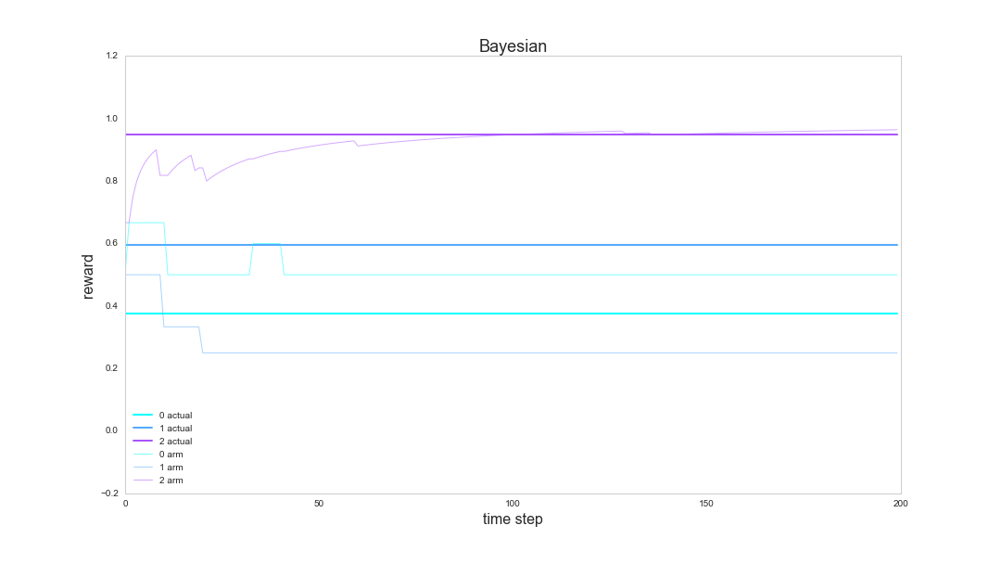
Bayesian - performance

Slide 46
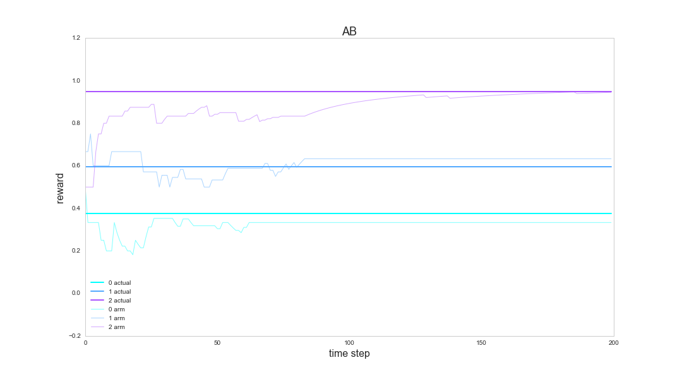
A/B testing - performance

Slide 47
Testing static data
test_static(k, T, actual, bandit)
This function handles most of the bookkeeping for a simulation of a single bandit algorithm
Function return rewards, arm_data, regret
do_sims(bandits, n_sims, k, T, data_gen, params)
bandits is a list of bandit classes
n_sims is the number of simulations
k is the number of bandits/arms
T is the number of time steps per simulation
data_gen is the data generator functions, e.g., gen_static_uniform
params holds extra values like alpha and beta for the Beta distribution
Notes:
Now we will compare the 4 bandit algorithms.
A lot of code to set up the simulations and track the results.
This function takes a two integer values, k and T, reward distributions, and a bandit algorithm.
It then simulates a system and captures the rewards.

Slide 48
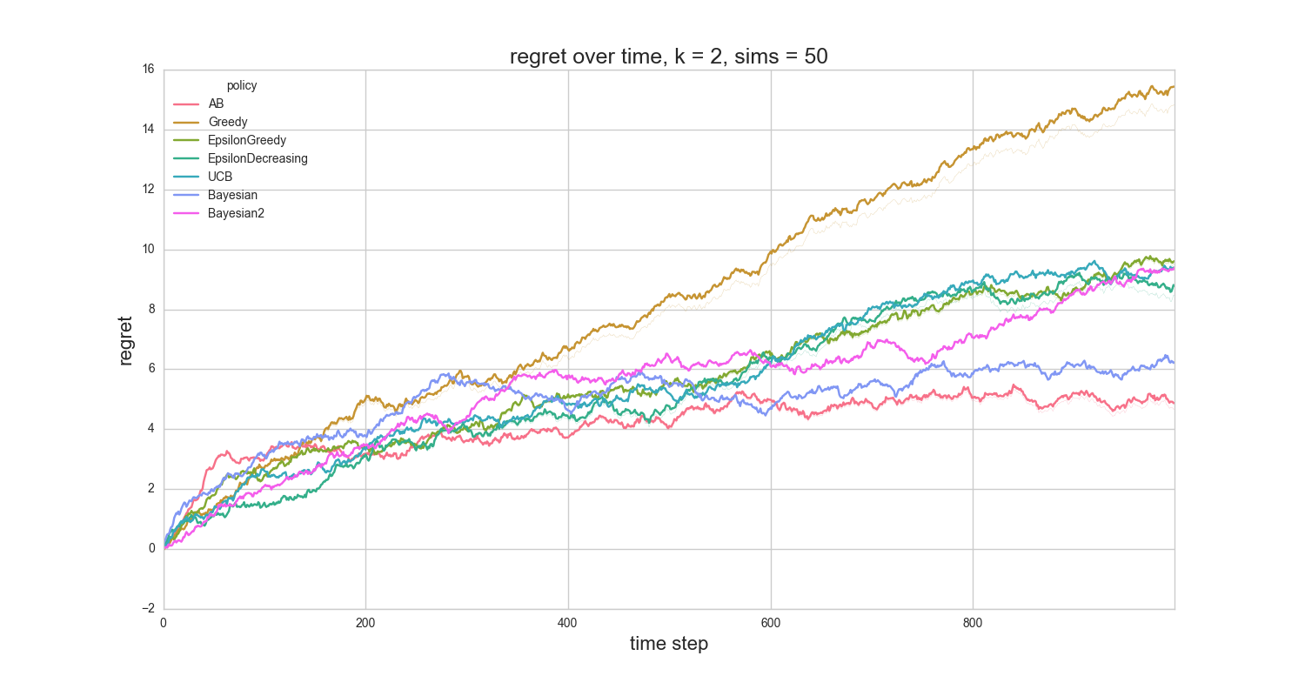
Bandit results on static data
Notes:
UCB has the lowest regret for practically the whole run of the simulation.
The x axis represents the time step. Remember that algorithm operates on a sequence, happening at time step 0, 1, 2, …50 in this case.

Slide 49
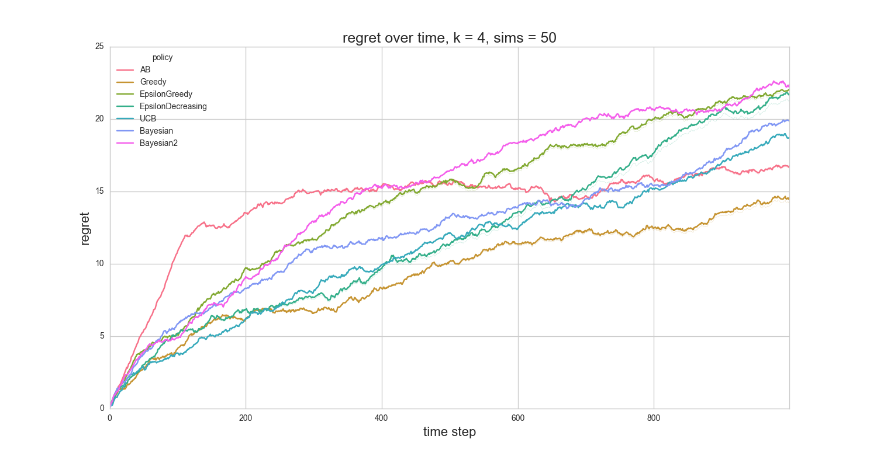
Bandit results on static data
Notes:
UCB has the lowest regret for practically the whole run of the simulation.
The x axis represents the time step. Remember that algorithm operates on a sequence, happening at time step 0, 1, 2, …50 in this case.

Slide 50
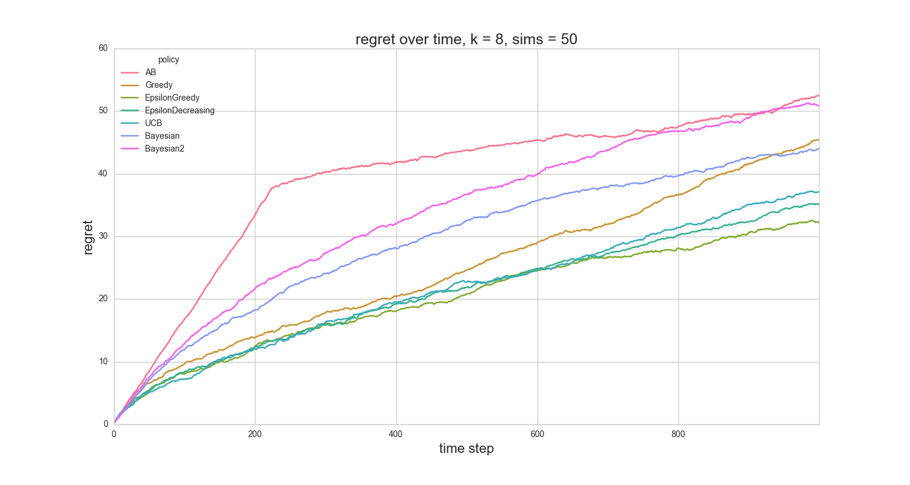
Bandit results on static data
Notes:
UCB has the lowest regret for practically the whole run of the simulation.
The x axis represents the time step. Remember that algorithm operates on a sequence, happening at time step 0, 1, 2, …50 in this case.

Slide 51
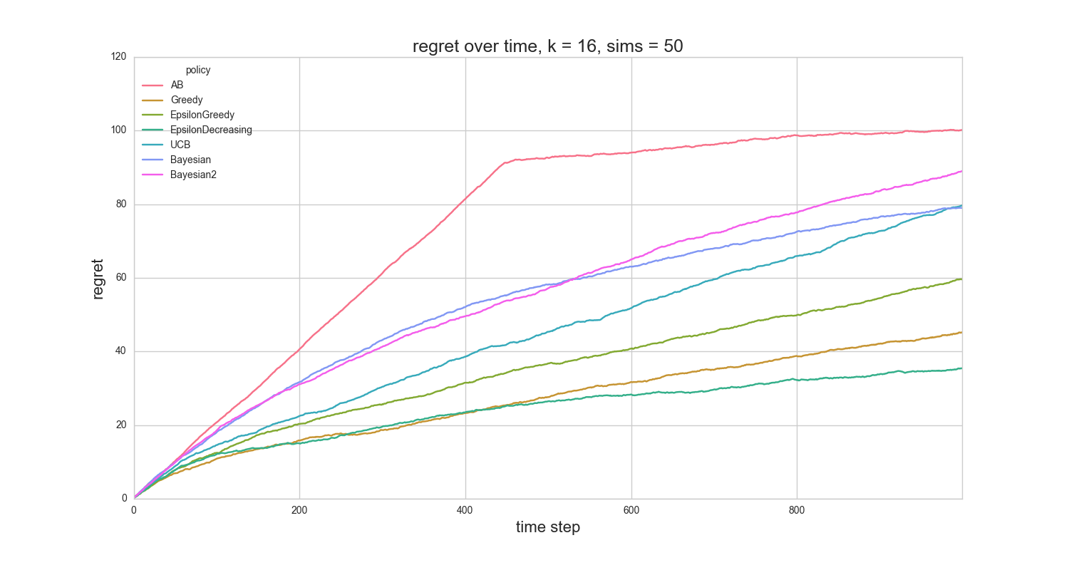
Bandit results on static data
Notes:
UCB has the lowest regret for practically the whole run of the simulation.
The x axis represents the time step. Remember that algorithm operates on a sequence, happening at time step 0, 1, 2, …50 in this case.

Slide 52
Volatile Bandits
Just like static bandits, except
Arms are born
Arms die
When an arm dies, it is replaced with a new arm
must reset the arm
One way to deal with massive data
Have N = 1,000,000 ads to serve?
Select k << N
Swap in/out ads
This maintains the k-arm bandit model

Slide 53
Volatile, uniform, static rewards
Notes:
For this particular data set, at any given point, there are 2 options/arms.
When one dies, it is replaced by another arm with a different reward.

Slide 54
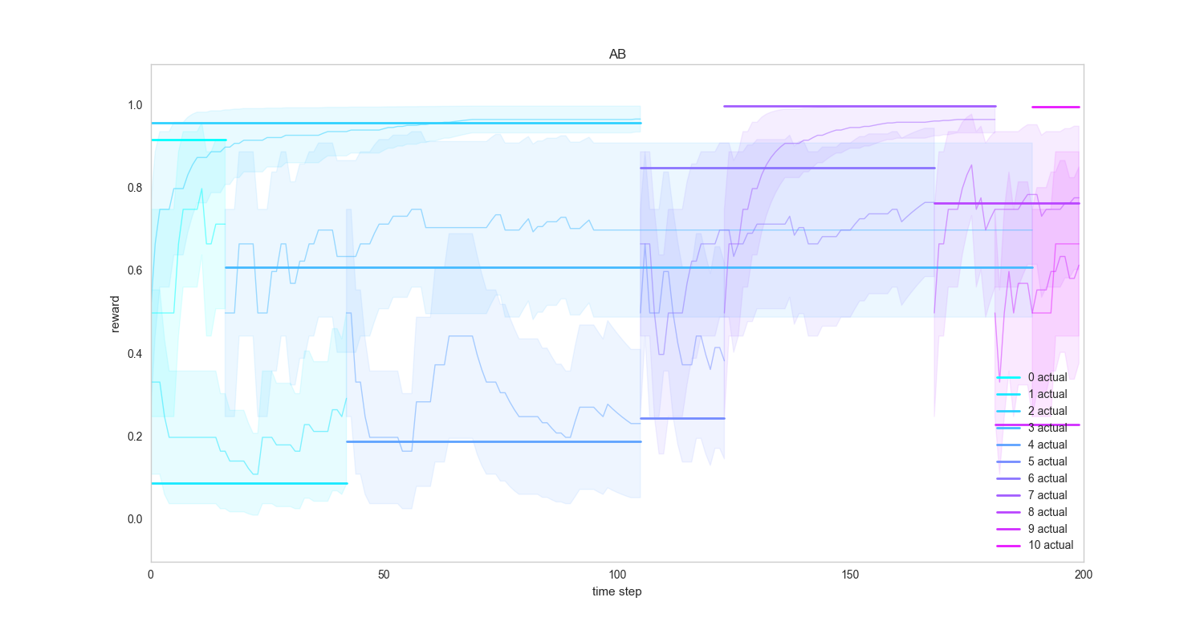
A/B – volatile static

Slide 55
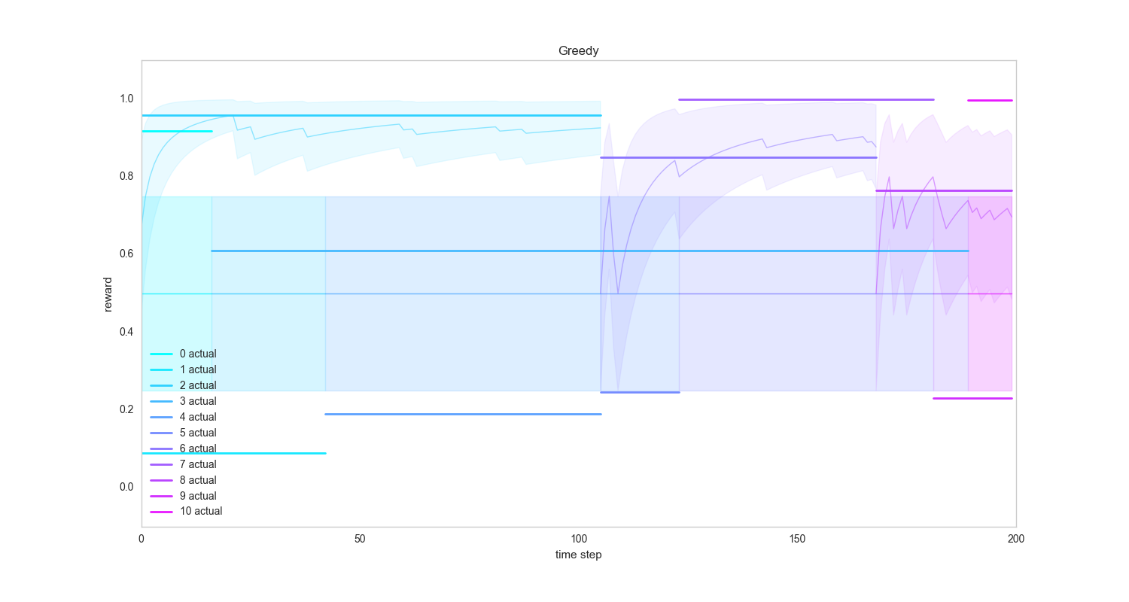
Greedy – volatile static

Slide 56
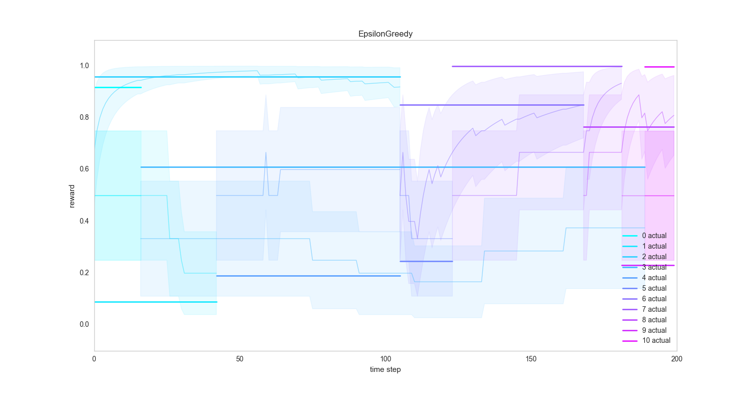
Greedy Epsilon – volatile static

Slide 57
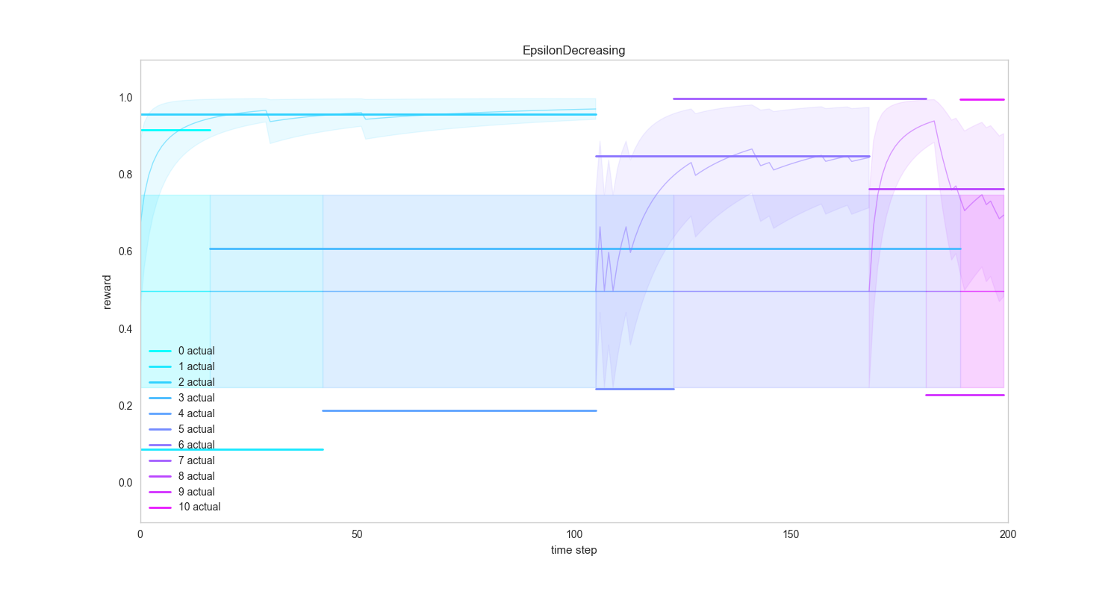
Epsilon Decreasing – volatile static

Slide 58
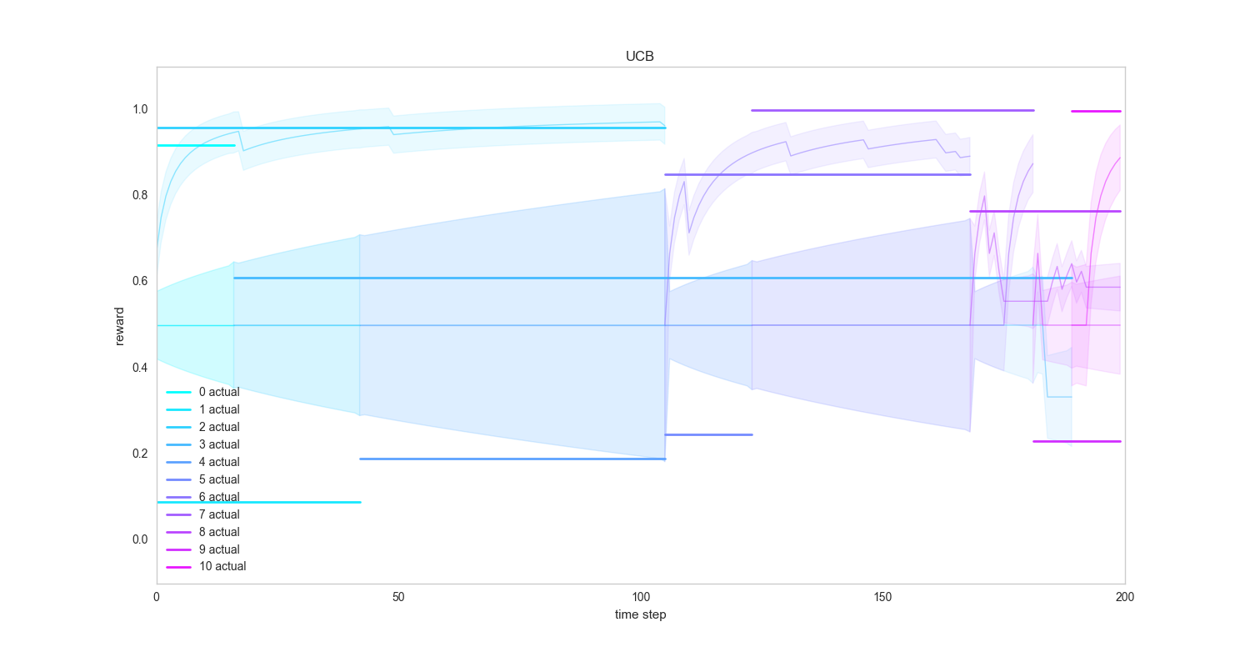
UCB – volatile static
Notes:
Maybe use “time step” or “trial” for x axis
Explain this verbally.

Slide 59
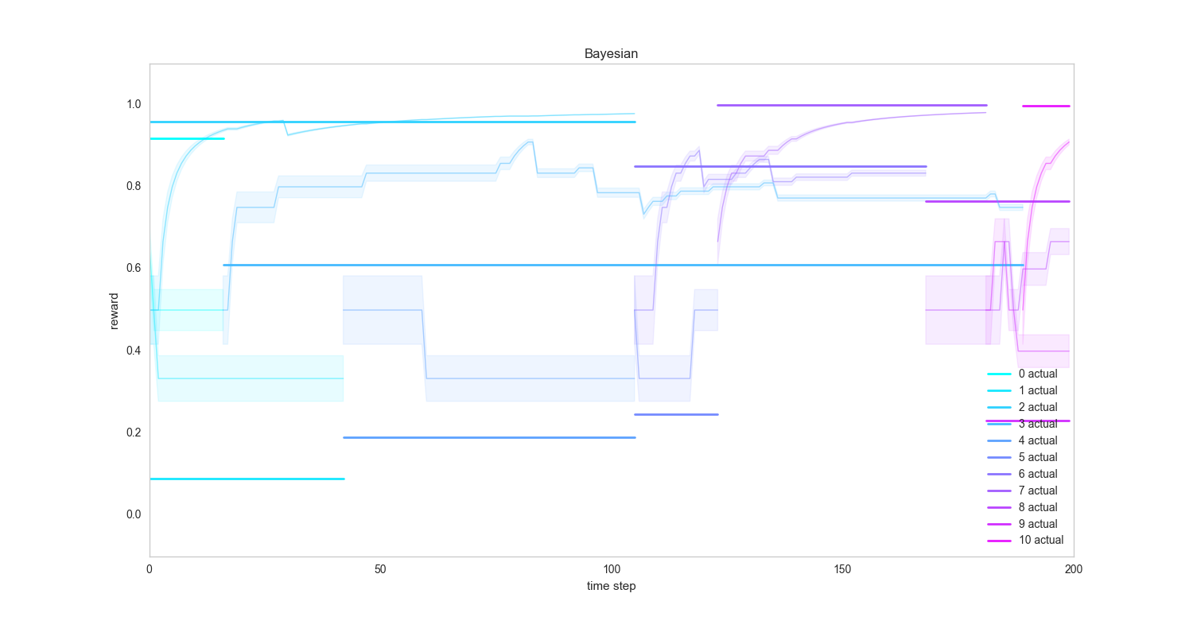
Bayesian – volatile static
Notes:
Maybe use “time step” or “trial” for x axis
Explain this verbally.

Slide 60
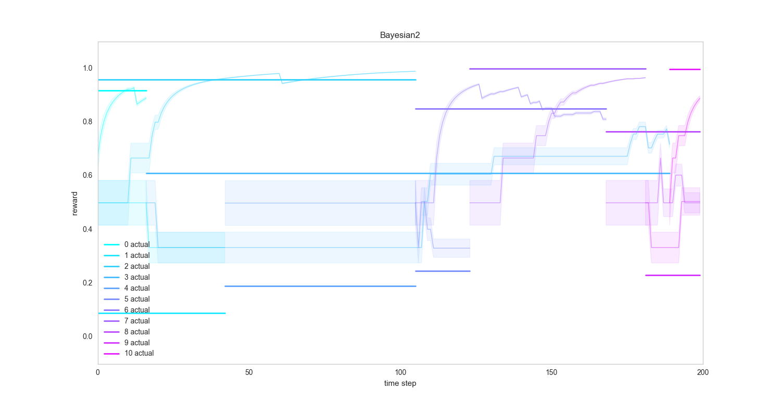
Bayesian2 – volatile static
Notes:
Maybe use “time step” or “trial” for x axis
Explain this verbally.

Slide 61
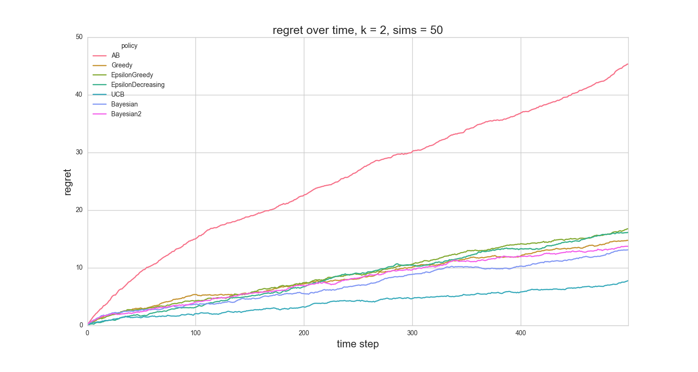
Regret on volatile data
Notes:
Add concrete examples for “regret”

Slide 62
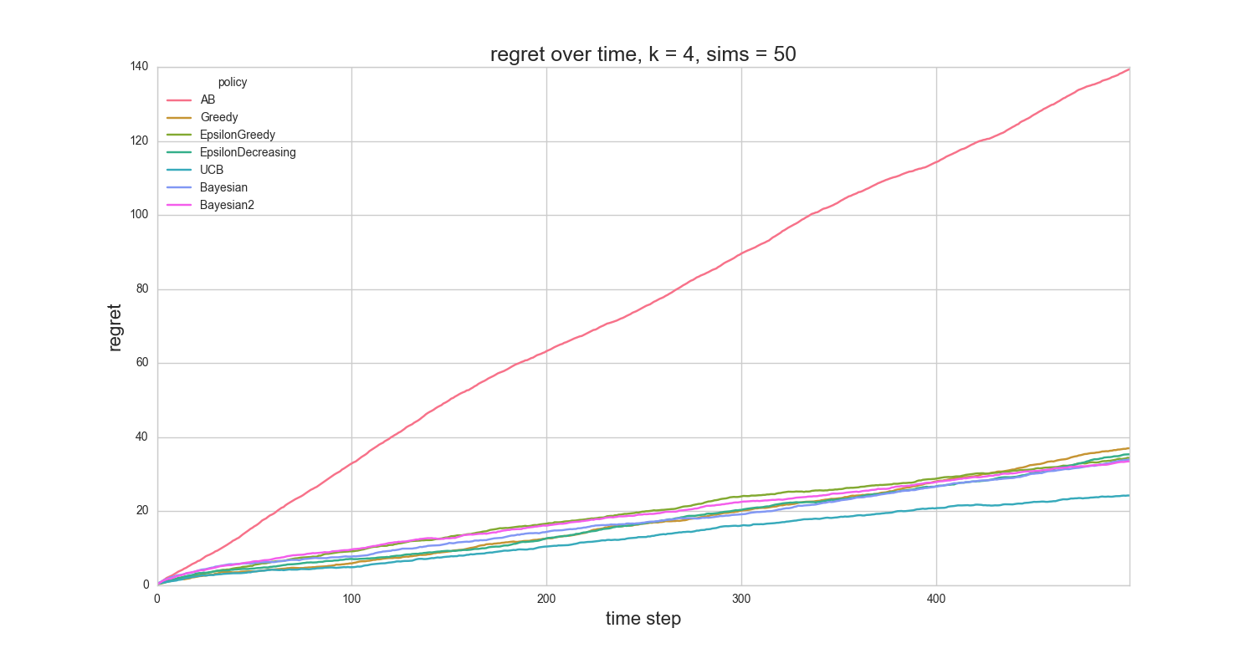
Regret on volatile data

Slide 63
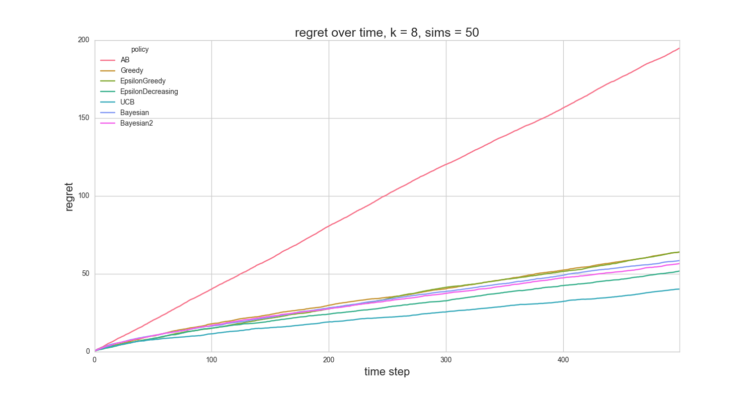
Regret on volatile data

Slide 64
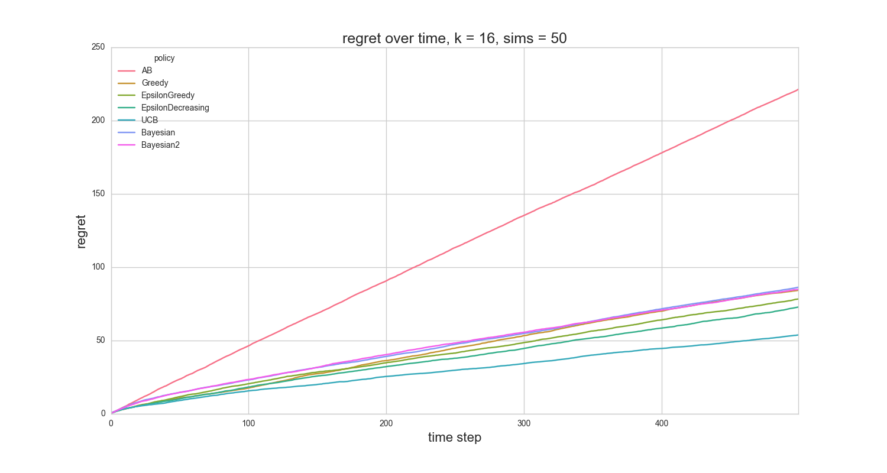
Regret on volatile data

Slide 65
Volatile, Restless Data

Slide 66
Volatile, Restless Bandits
Just like volatile bandits, except
Expected rewards of arms changes over time

Slide 67
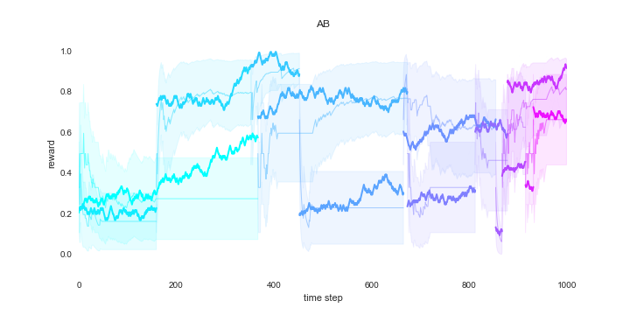
A/B - volatile, restless

Slide 68
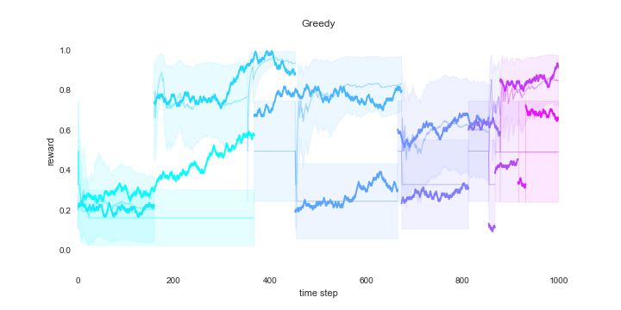
Greedy - volatile, restless

Slide 69
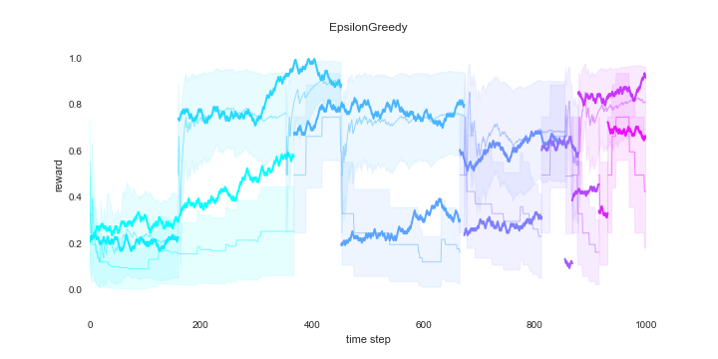
Epsilon Greedy - volatile, restless

Slide 70
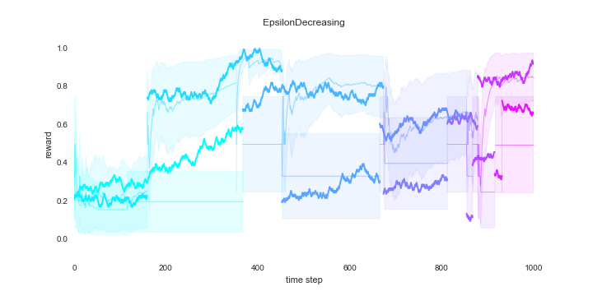
Epsilon Decreasing - volatile, restless
Notes:
Highlight differences between this and previous plot

Slide 71

UCB - volatile, restless

Slide 72

Bayesian - volatile, restless

Slide 73

Bayesian2 - volatile, restless

Slide 74

Regret on Restless, Volatile

Slide 75

Regret on Restless, Volatile

Slide 76

Regret on Restless, Volatile

Slide 77

Regret on Restless, Volatile

Slide 78
Restless, Non-volatile
Same function used to generate restless volatile
Just change the p parameter in the call to gen_volatile_restless_data()
This will change the probability of arm death to zero

Slide 79

Restless data

Slide 80

A/B on Restless, non-volatile

Slide 81

Greedy on Restless, non-volatile

Slide 82

Epsilon Greedy on Restless, non-volatile

Slide 83

Epsilon Decreasing on Restless , non-volatile
Notes:
Add the sine wave,
contextualize

Slide 84

UCB on Restless , non-volatile

Slide 85

Bayesian on Restless , non-volatile

Slide 86

Bayesian2 on Restless , non-volatile

Slide 87

Regret on restless, non-volatile data

Slide 88

Regret on restless, non-volatile data
Notes:
Uh oh. When we zoom out, we see that the bandit algorithms get worse over time.
This is due to the fact that the rewards are changing.

Slide 89

Regret on restless, non-volatile data
Notes:
Uh oh. When we zoom out, we see that the bandit algorithms get worse over time.
This is due to the fact that the rewards are changing.

Slide 90

Regret on restless, non-volatile data
Notes:
Uh oh. When we zoom out, we see that the bandit algorithms get worse over time.
This is due to the fact that the rewards are changing.

Slide 91
Heuristics and Variations
For Bayesian bandits
Keep alpha + beta < c
This ensures change is possible without restarts
Cannot go down a path from which it is difficult to return
How to determine c?
Other heuristics
Sliding windows
Added space requirements
Set default values optimistically
Max of possible expected values, e.g., 1.0
Max of current expected values, e.g., 0.745
Notes:
Uh oh. When we zoom out, we see that the bandit algorithms get worse over time.
This is due to the fact that the rewards are changing.

Slide 92
Machine Learning Application
K-Nearest Neighbors
Arms = [1, 2, …, k, k+1, …, n]
Use bandit to determine the optimal k
Multi-level multi-armed bandit (MLMAB) for Ensembles
Given: n classifiers
Two stages:
Determine the optimal number k of classifiers to use
Select which k from the n to use
Could help with seasonality
Recommender Systems
Thompson sampling (Bayesian bandits) to select the top k things to present to a user
r.v. ensures a chance that unpopular things will (occasionally) be seen (this is exploration)
Notes:
Uh oh. When we zoom out, we see that the bandit algorithms get worse over time.
This is due to the fact that the rewards are changing.

Slide 93
Conclusion
Continuous experimentation often outperforms A/B testing
Finds the best option faster
Updatable
Drop in a new choice, and the algorithm will explore it
Things to consider
Market segmentation
Bandit is more difficult to implement and explain
How to architect this for a large number of arms?
Priority Queue
Ordered list
Distributed updates
Delay

Slide 94
Optional Reading List
Using Confidence Bounds for Exploitation-Exploration Trade-offs
Finite-time Analysis of the Multiarmed Bandit Problem
A Contextual-Bandit Approach to Personalized News Article Recommendation
Mortal Multi-armed Bandits
Online Learning of Rested and Restless Bandits

